Slide 1
Eric Zhao
Final
Presentation

Slide 2
Eric Zhao
DEMO
ericzhao05.com
Page | 01

Slide 3
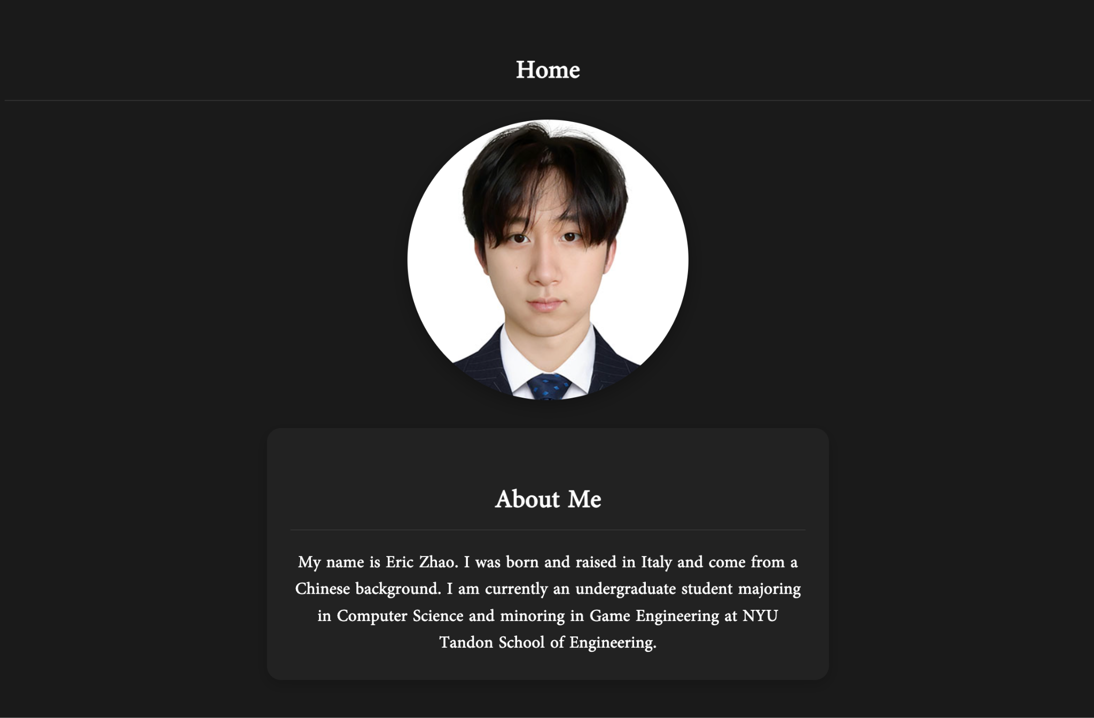
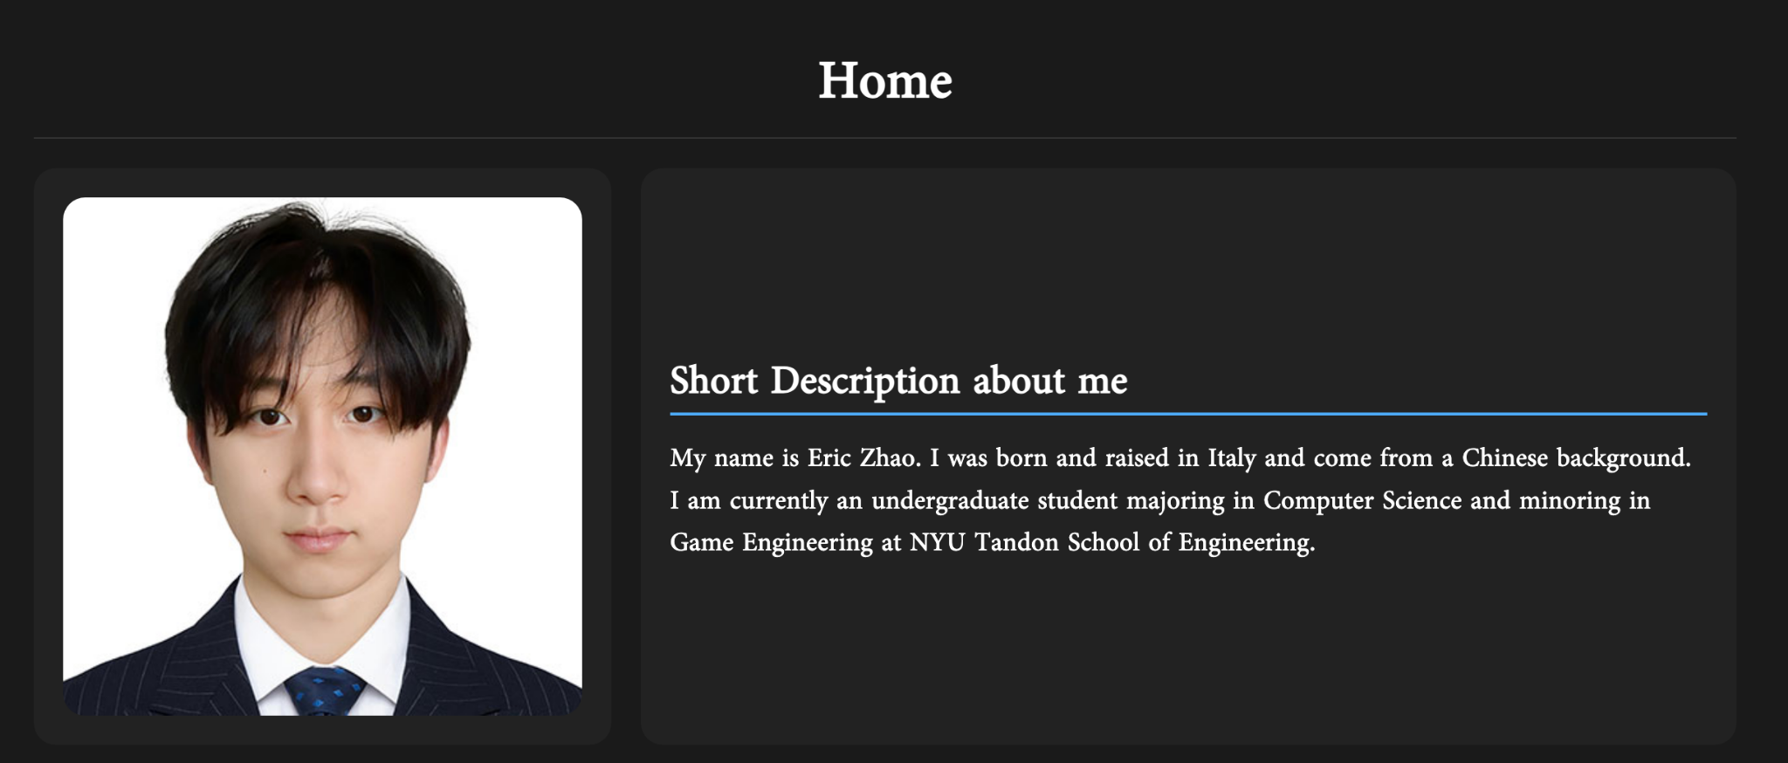
Eric Zhao
Progress
Page | 02

Slide 4
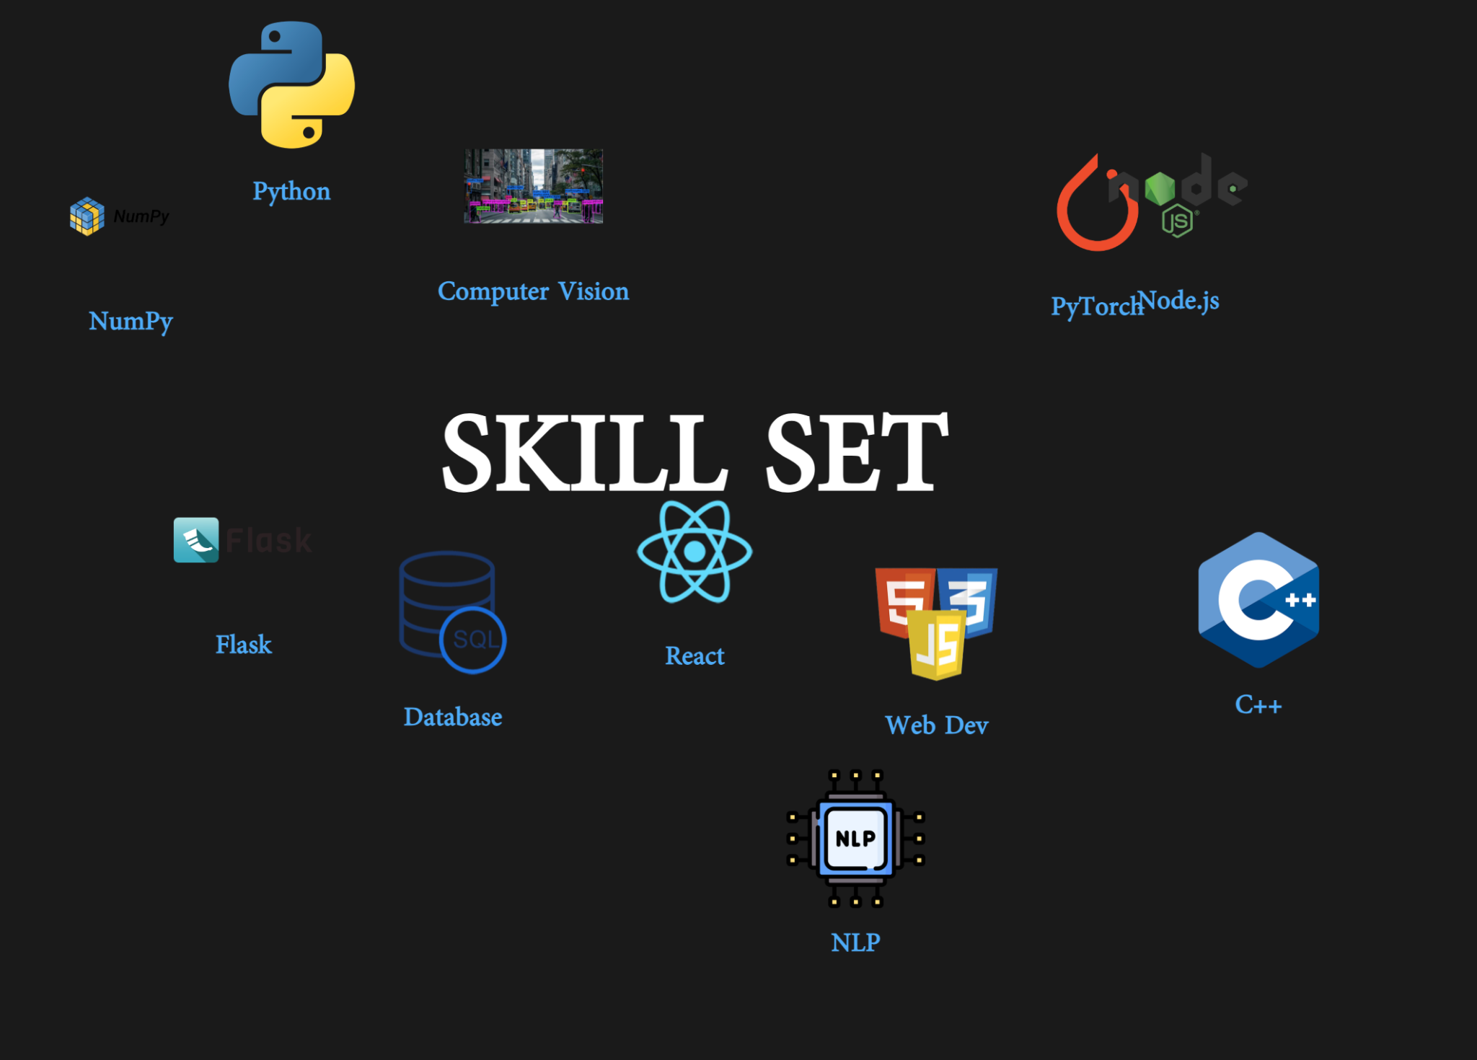
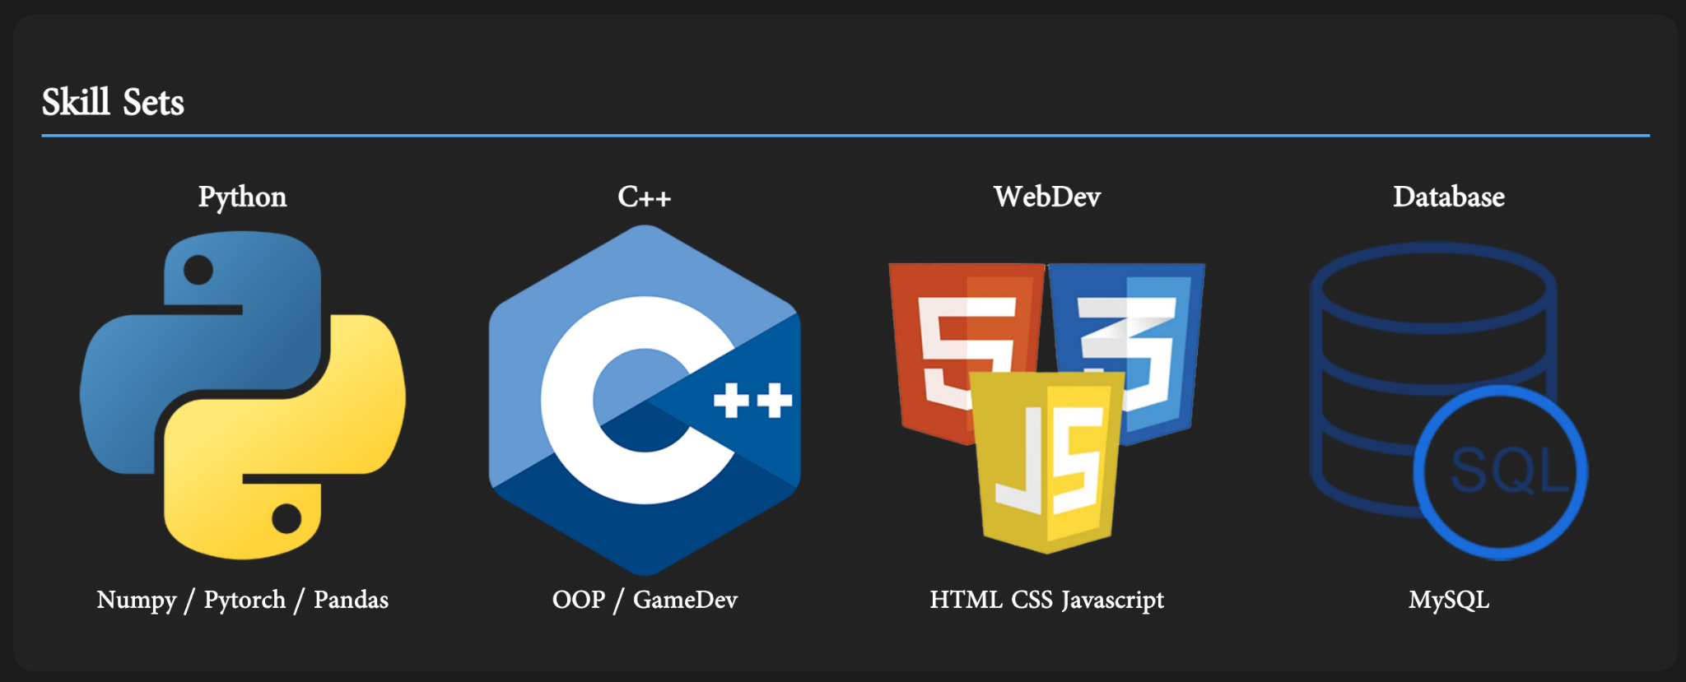
Eric Zhao
Progress
Page | 03

Slide 5
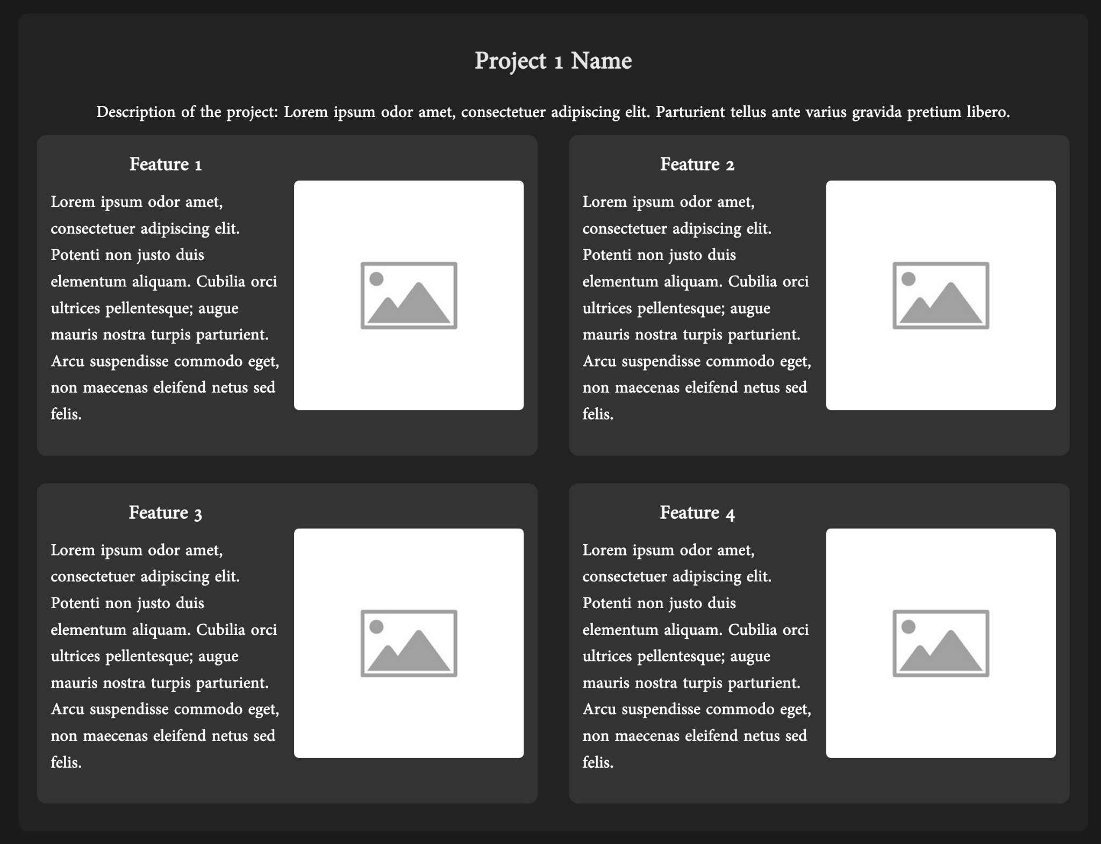
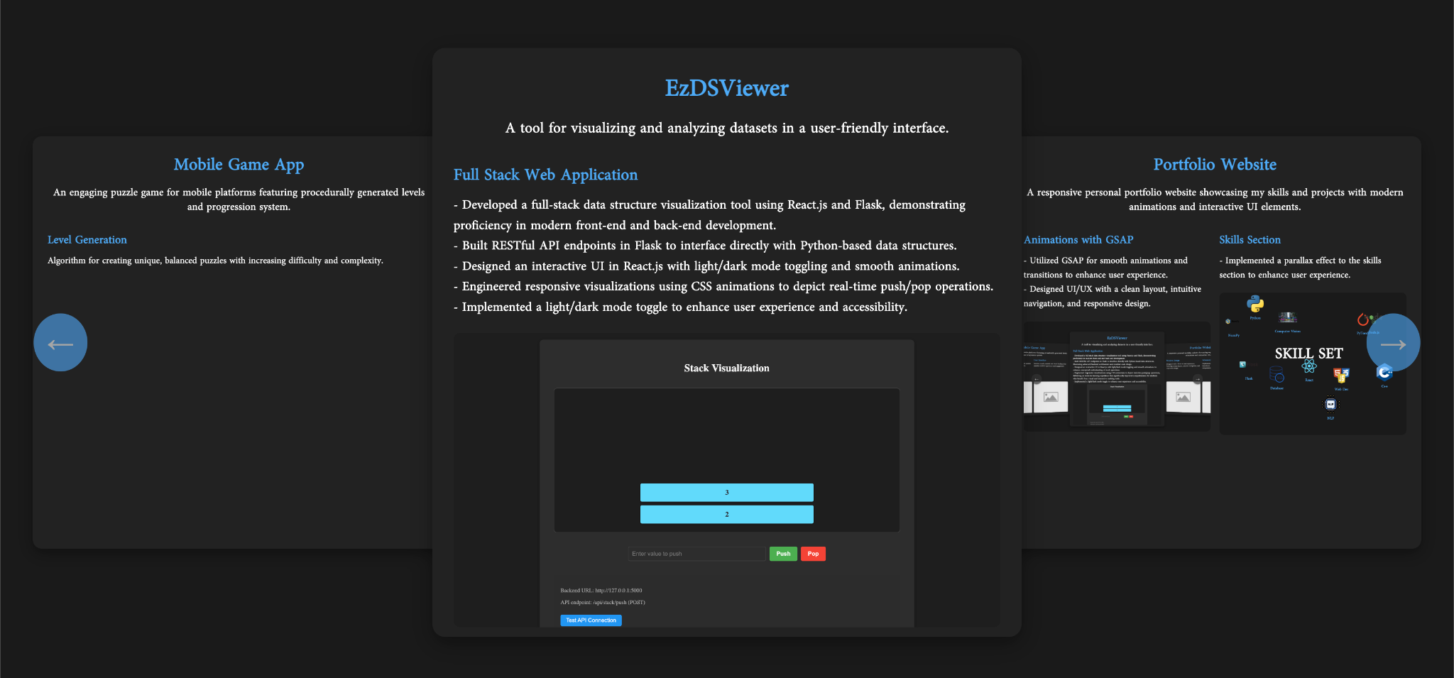
Eric Zhao
Progress
Page | 04

Slide 6
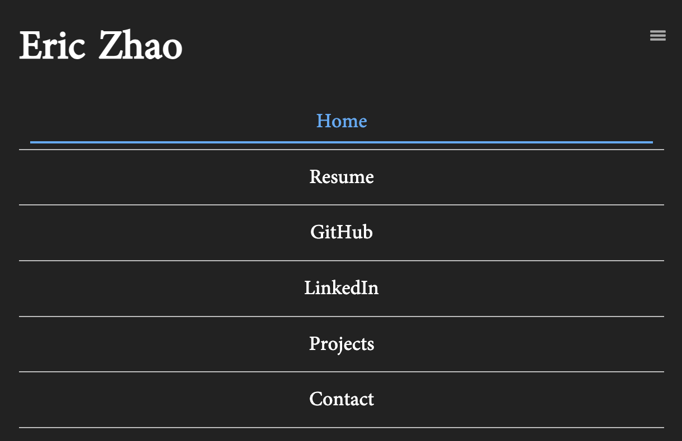
Eric Zhao
Media Query: Mobile
Page | 05

Slide 7
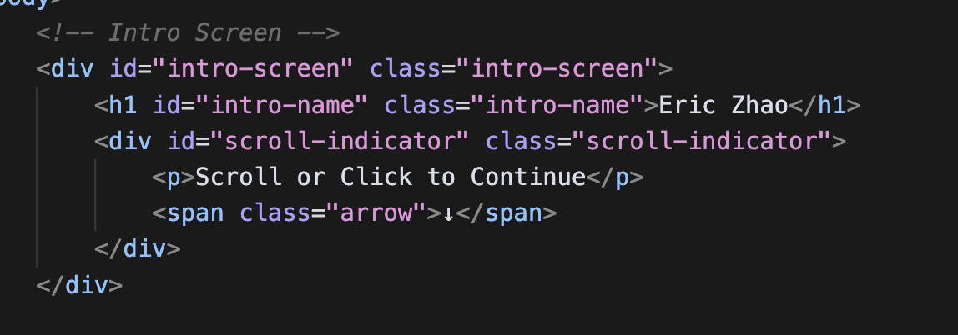
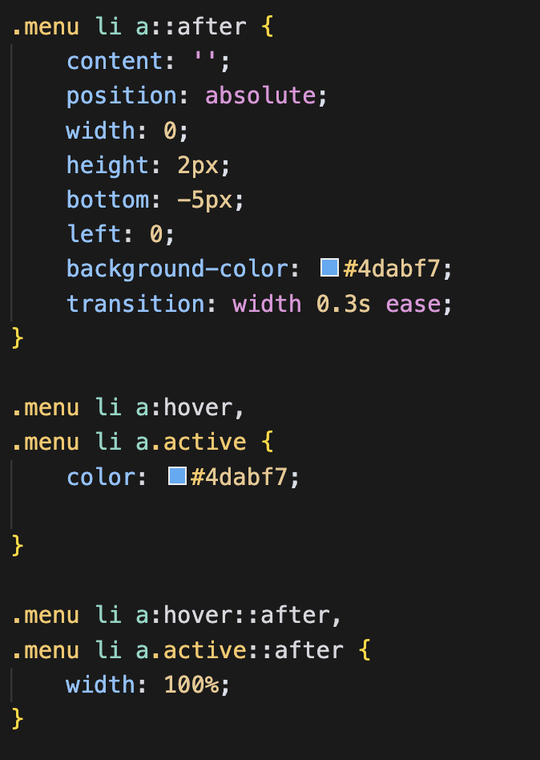
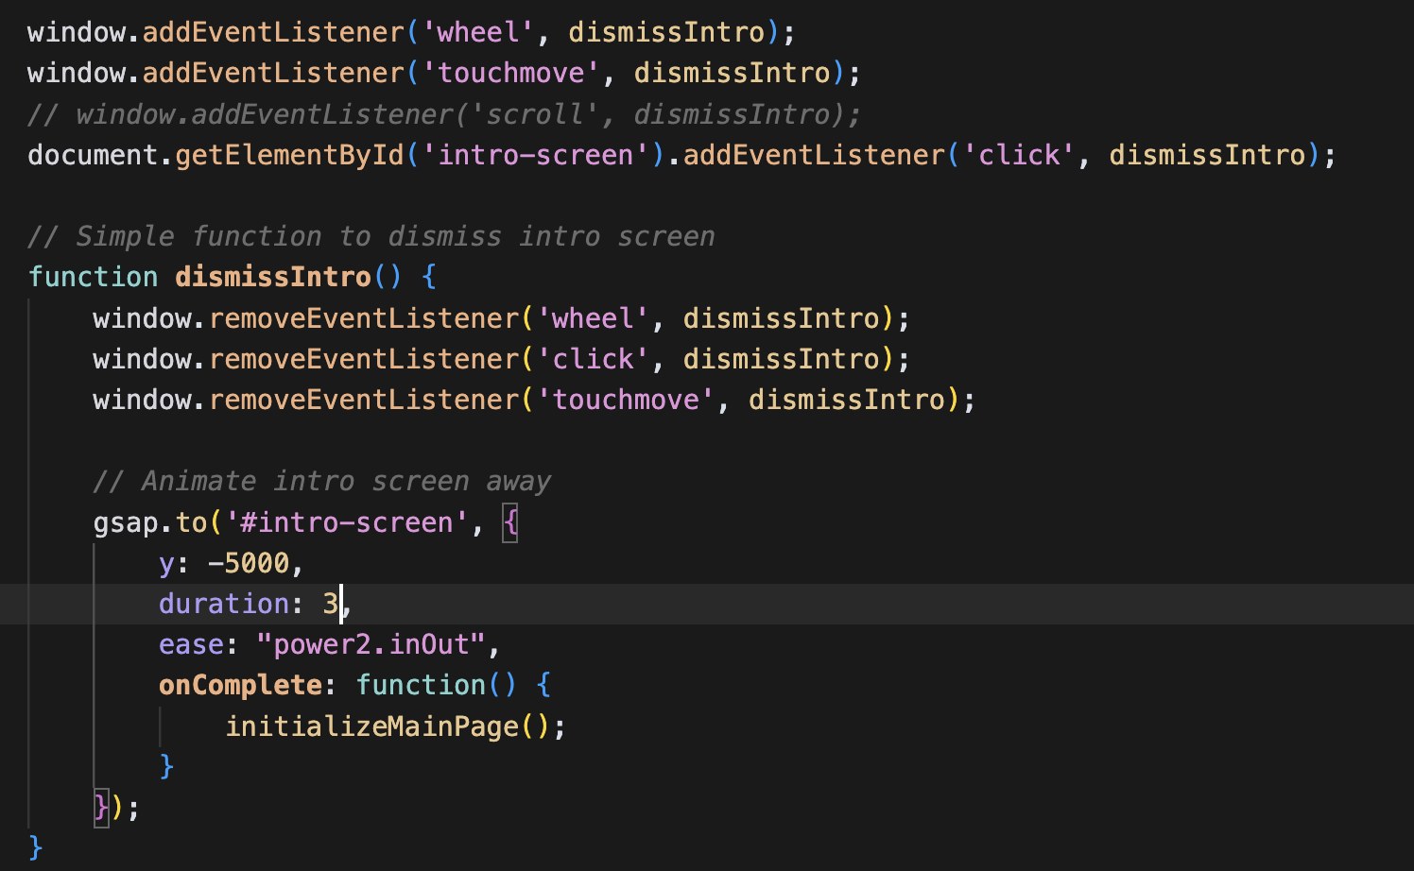
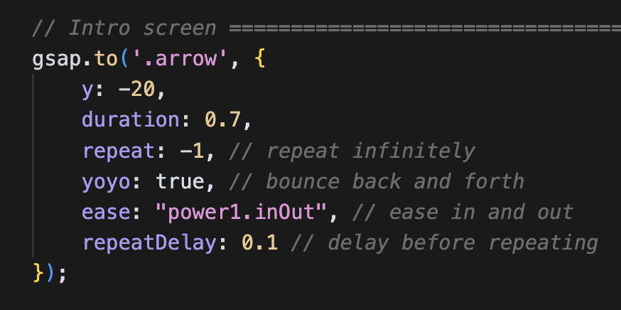
Eric Zhao
Code Snip
Simple GSAP Animation for the Intro Screen
CSS Underline Animation
Page | 06

Slide 8
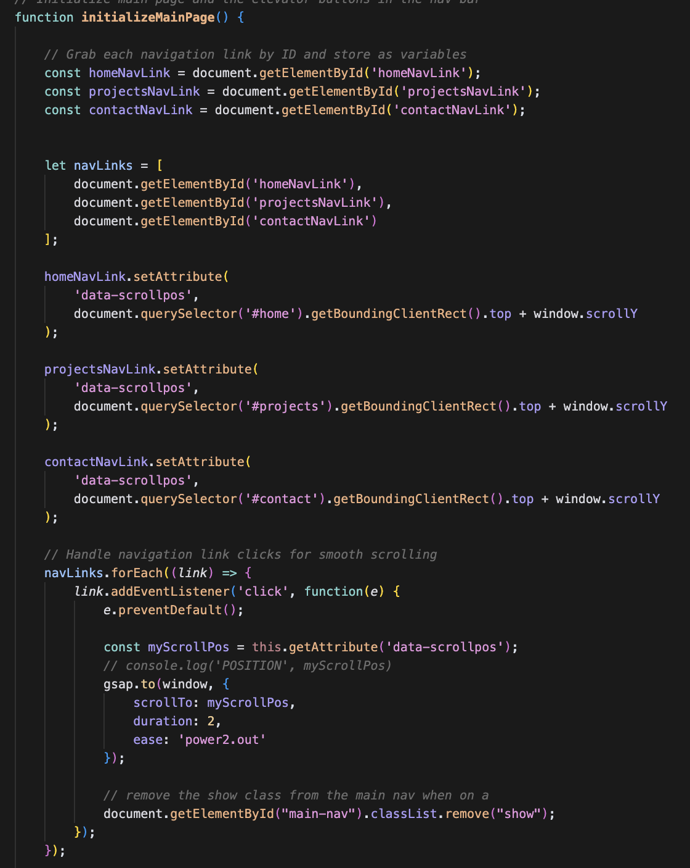
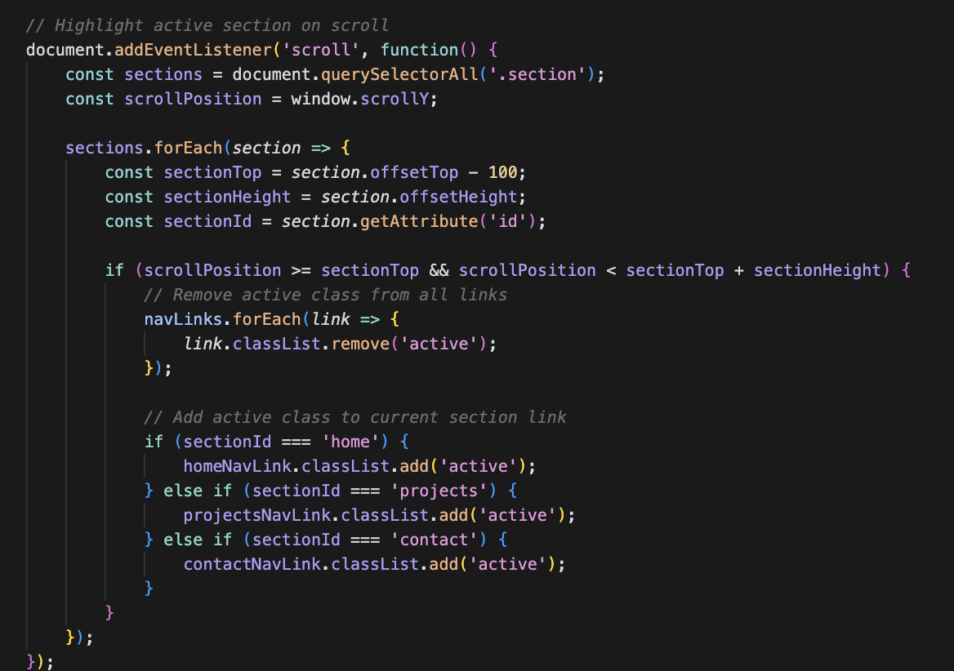
Eric Zhao
Code Snip
Highlight active section on scroll
Elevator Buttons
Page | 07

Slide 9
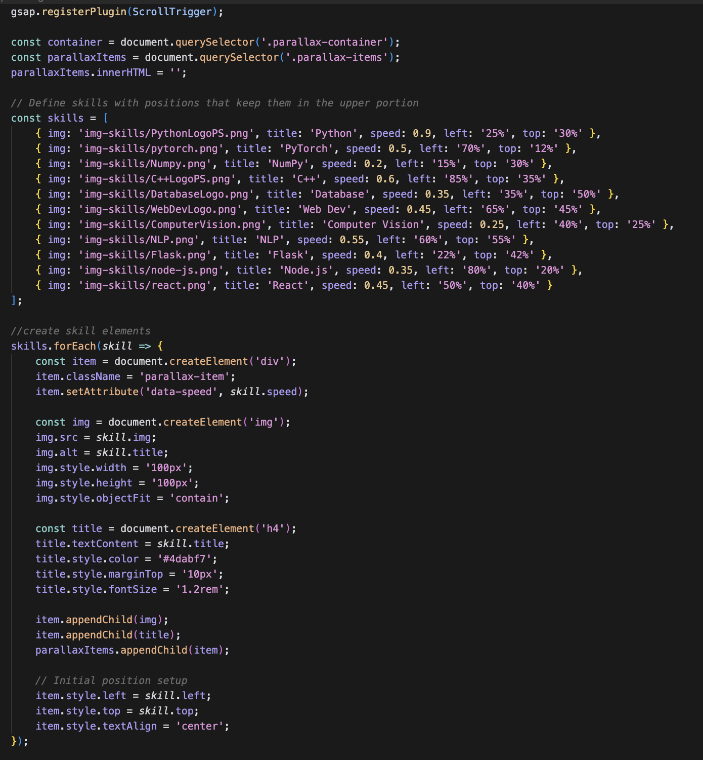
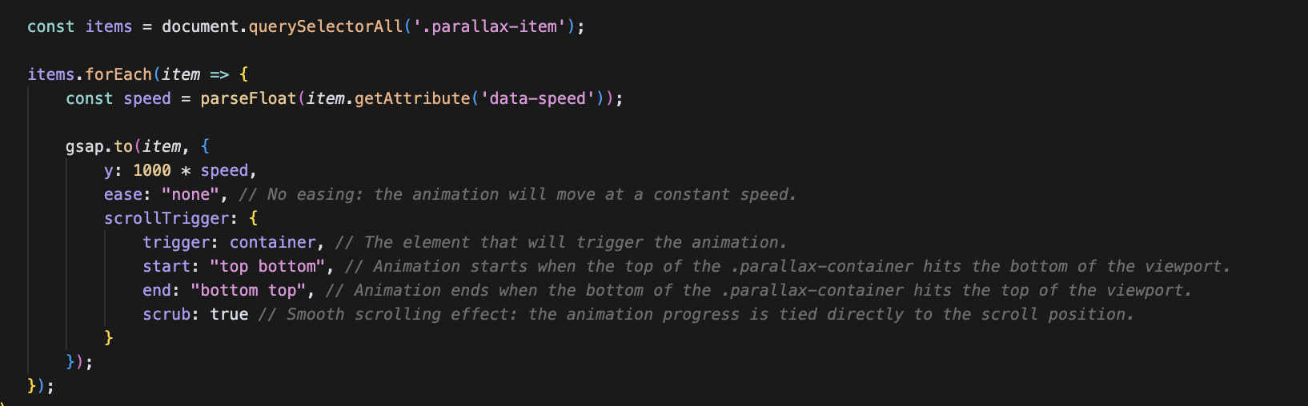
Eric Zhao
Interesting Code
Used GSAP Plugin — ScrollTrigger
Style using Javascript
Page | 08

Slide 10
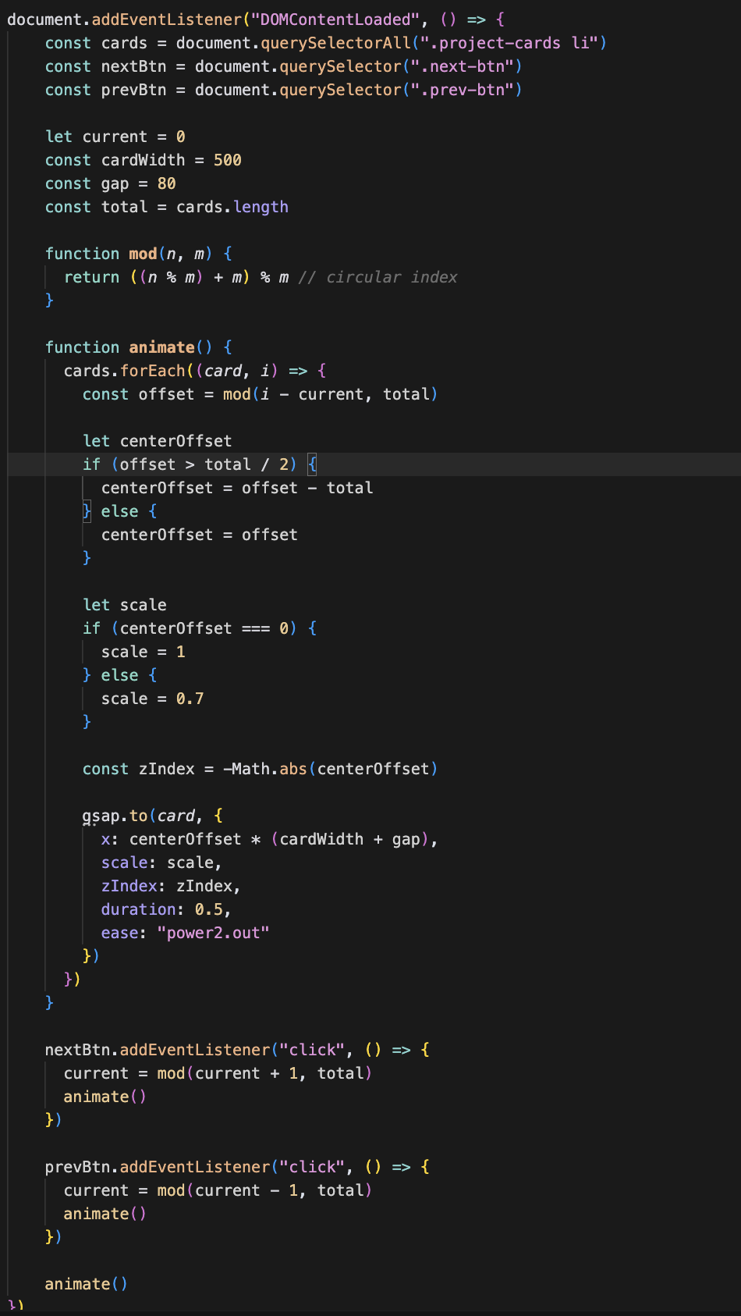
Eric Zhao
Challenge/ Issue
Carousel for Project Display
List of resources used:
https://codepen.io/GreenSock/pen/RwKwLWK
https://glidejs.com/
https://codepen.io/chingy/pen/yLLZRbj
https://codepen.io/Mrrowlie/pen/bGbLOdv
https://codepen.io/tutsplus/pen/MWZwrGJ
Page | 09

Slide 11

Eric Zhao
Concepts I learned
HTML
How to link to local javascript files
CSS
Use ::after to make underlying animation
Use transform: translateX(-50%) to shift half its own width to center it
Use flex: 1 1 calc(33.333% - 10px):
1 → can grow to fill available space
1 → can shrink when needed
calc(33.333% - 10px) → Make this element take up one-third of the container’s width, minus 10 pixels.
Viewport width (vw) & viewport height (vh)
Javascript
Use of GSAP Plugin
How to read and understand javascript code
How to create parallax scrolling effect
Finding the proper spot for elevator using: top + window.scrollY
Window.addEventListener(“wheel”): activate when mouse wheel or trackpad swipe
Window.addEventListener(“wheel”): when finger moves across screen
Horizontal scrolling using arrows (circular indexing)
Creating, adding, and styling elements in Javascript and inject (append) it in the HTML file
Page | 10

Slide 12

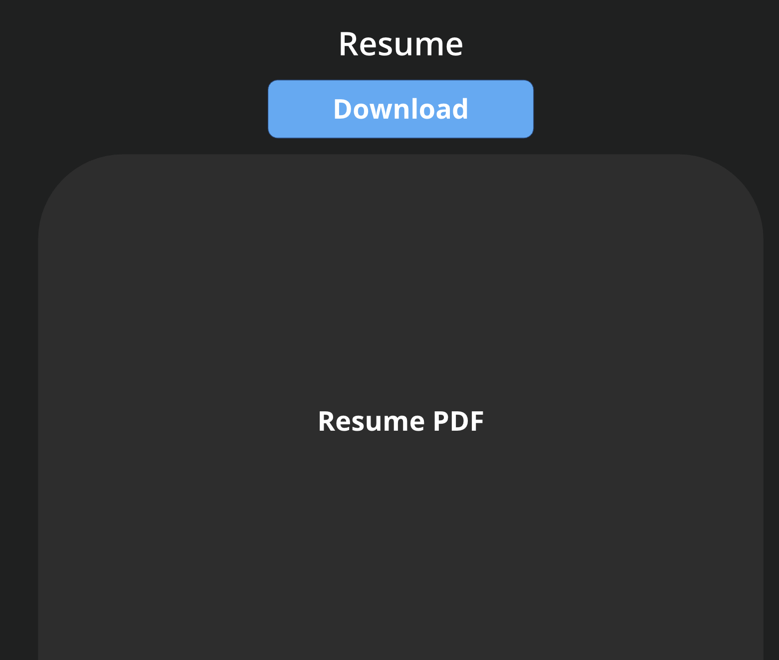
Eric Zhao
Future Steps
Fix media queries for mobile users
Add in more javascript
Type up my resume in HTML
Add a download button for my resume
Implement of scroll animation in my contact page
Fix the intro page (sometimes it behaves weird)
Page | 11

